Slide 1


The AWP group of hotels:

Slide 2
Group members:
Aditya Dhane: BT18CSE028
Contribution:
All Admin Related Functions
Booking and Database
Front End
Hardik Bhatia: BT18CSE118
Contribution:
MVC model
Booking and Database
Version Management
Front End
Kaustubh Wankhede: BT18CSE006
Contribution:
Email sending
Javascript Validation
PPT making
Front End
Kaustubh Kathare: BT18CSE024
Contribution:
AJAX
Servlets
Model Classes
Front End
Rohan Patil: BT18CSE022
Contribution:
final.jsp
Logout function
PPT making and Front End

Slide 3
SITE MAP
The following site map is proposed .
The site map may change during the development of the website
Home page- Including an introduction About us , subscriber login and register form, contact us form
Booking page- Rooms displayed along with there prices and availability .Information regarding check in ,check out and no. Of people to be filled by user
Admin page- for admin use only, to assist your stay at hotel
Contact us page- Includes your identity, email address on the online contact form to minimize spam email messages

Slide 4

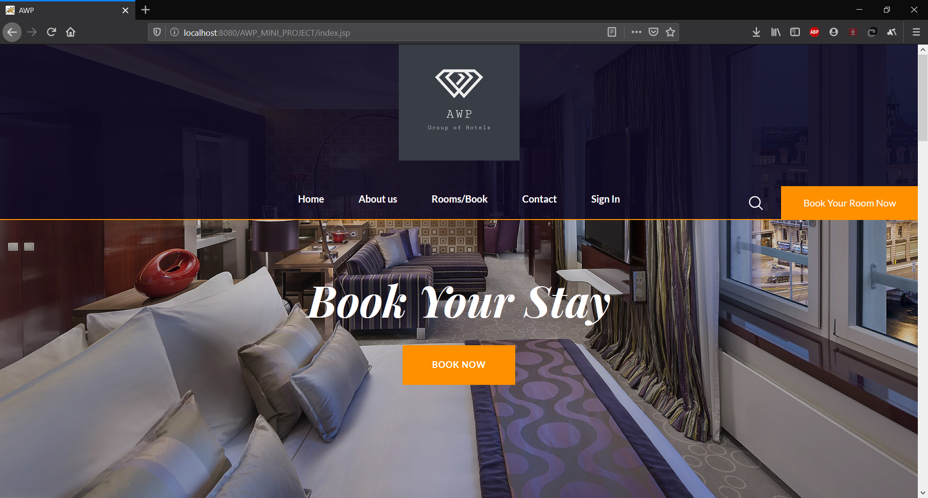
Home Page
The home or Index page of the Hotel Website allows you to read about us, contact us, book rooms, and sign in to your AWP hotels account

Slide 5
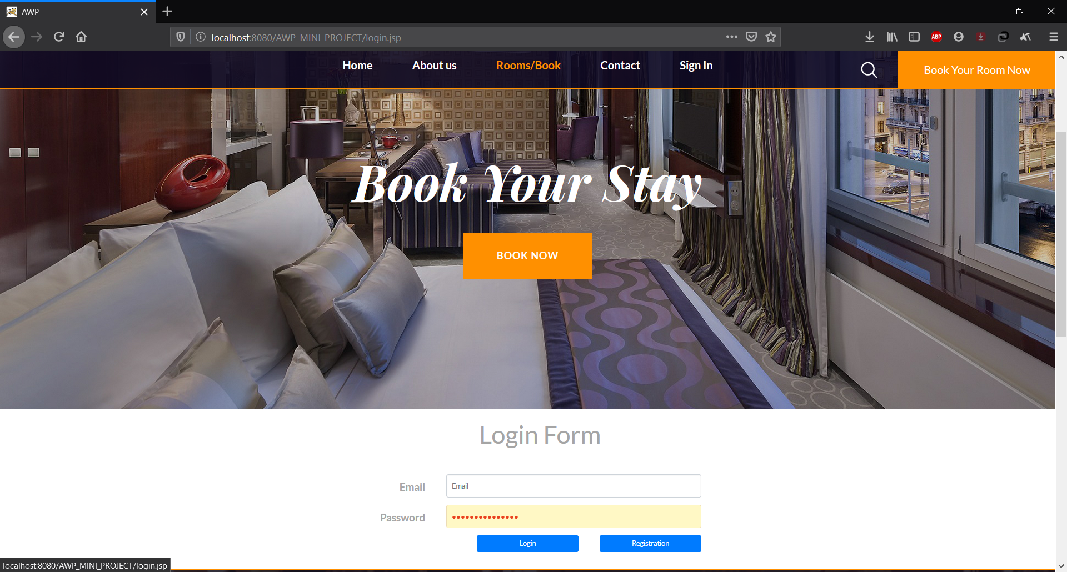
login.jsp
Before booking your stay, you need to login into our database, as a member of AWP hotels.

Slide 6
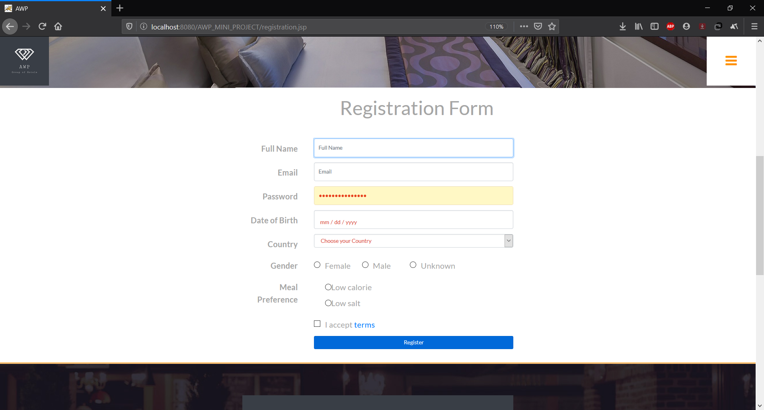
Register.jsp
If you are not a part of our AWP Hotels family, you can register into our database through this simple form!

Slide 7

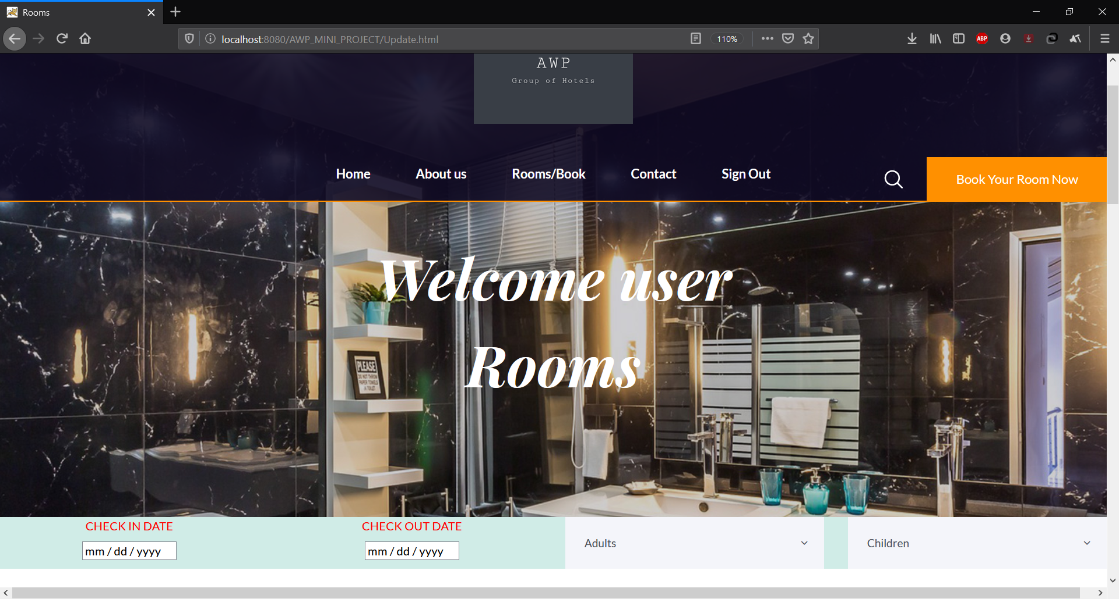
Booking Page
Here, you can book your room on basis of duration of stay, and the number of occupants for each room.

Slide 8
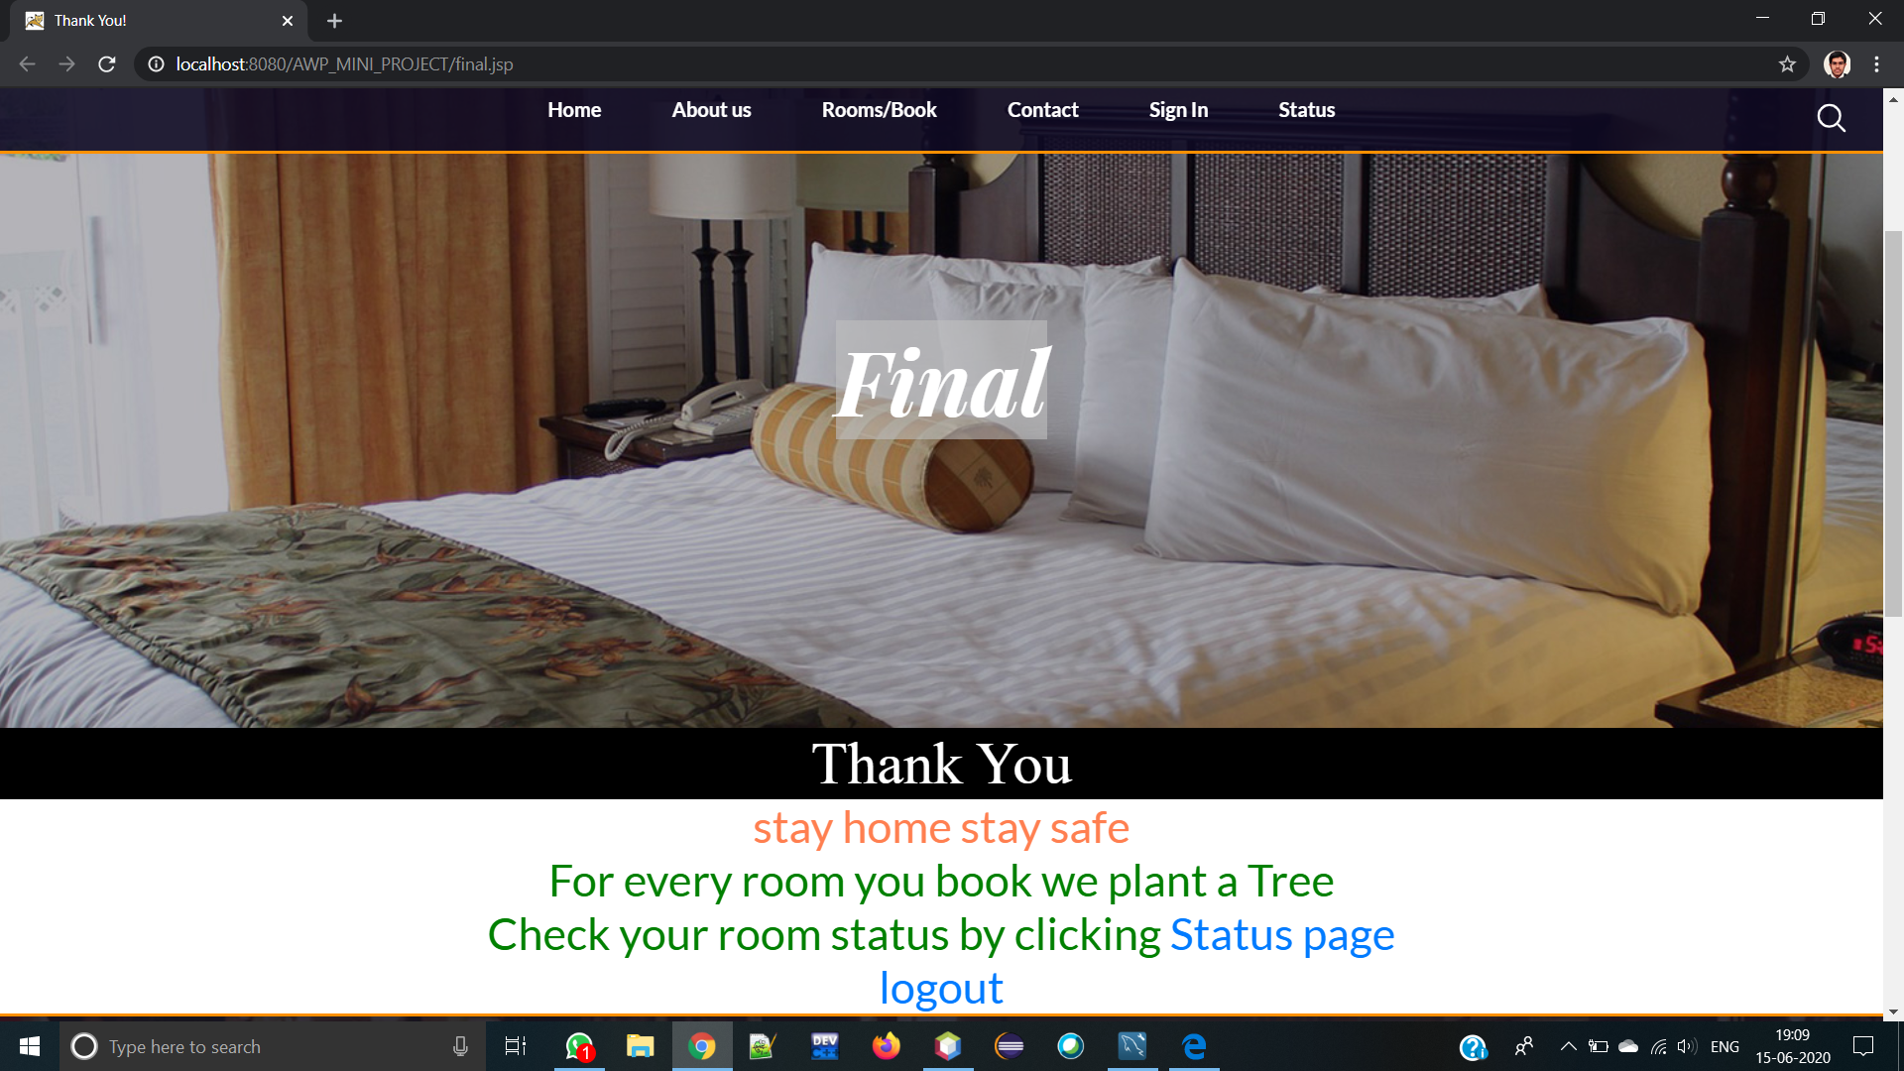
Final.jsp
After Successfully booking your page, you will be directed to our vote of thanks, and allow you the facility to check your booking status or logout.

Slide 9
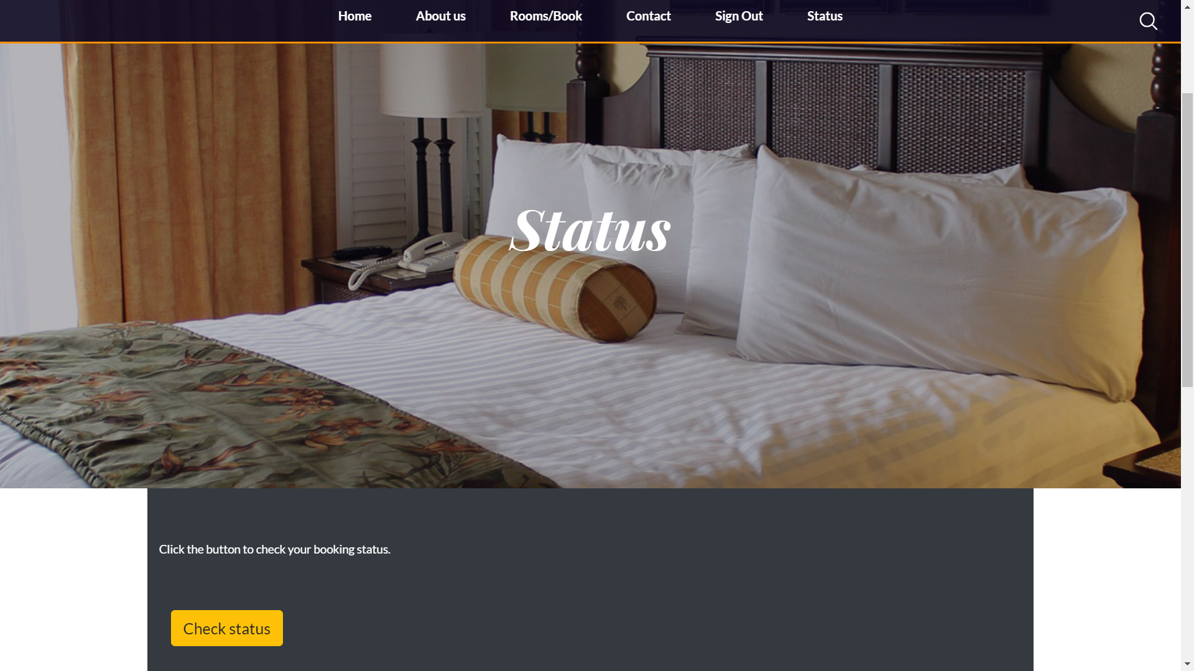
Booking Status
You can check your booking status on this page, by clicking on the check status button.

Slide 10
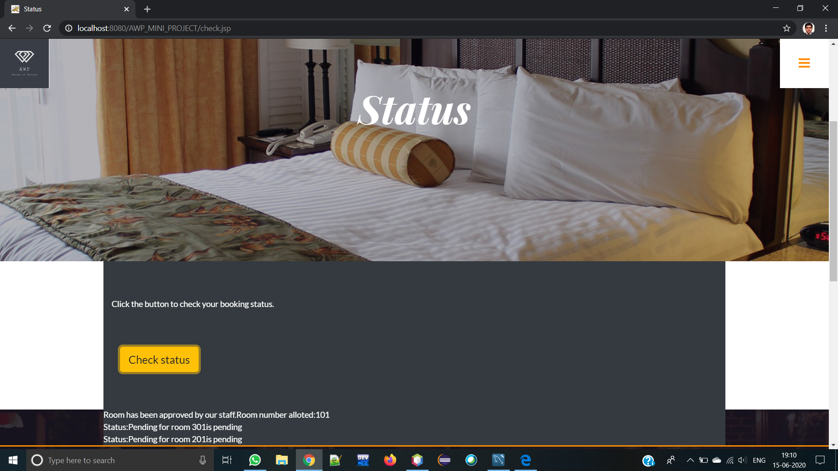
AJAX dynamic response
When you press the button, the page will dynamically change using AJAX to show you your current booking status

Slide 11
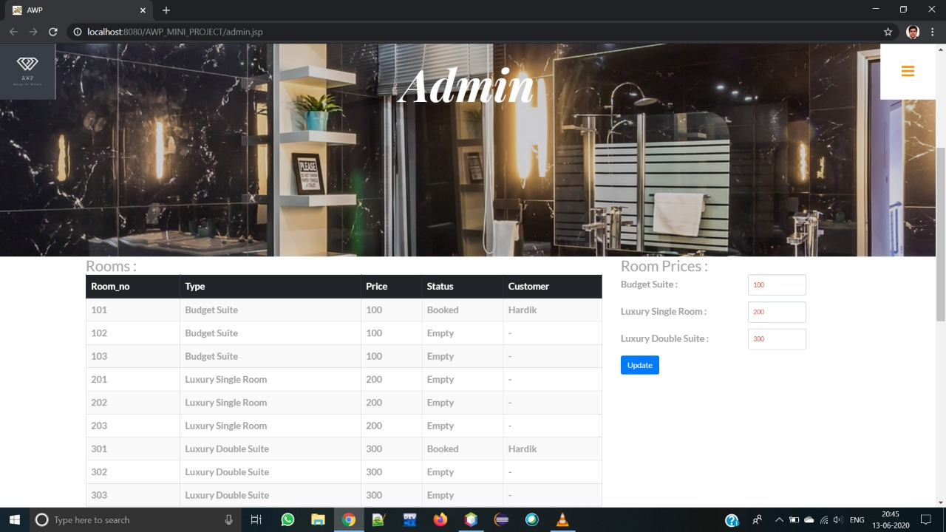
Admin Page
The Administrator of AWP hotels is authorized to set cost of rooms and see the status of all rooms, and their occupants, to improve your stay at AWP hotel

Slide 12
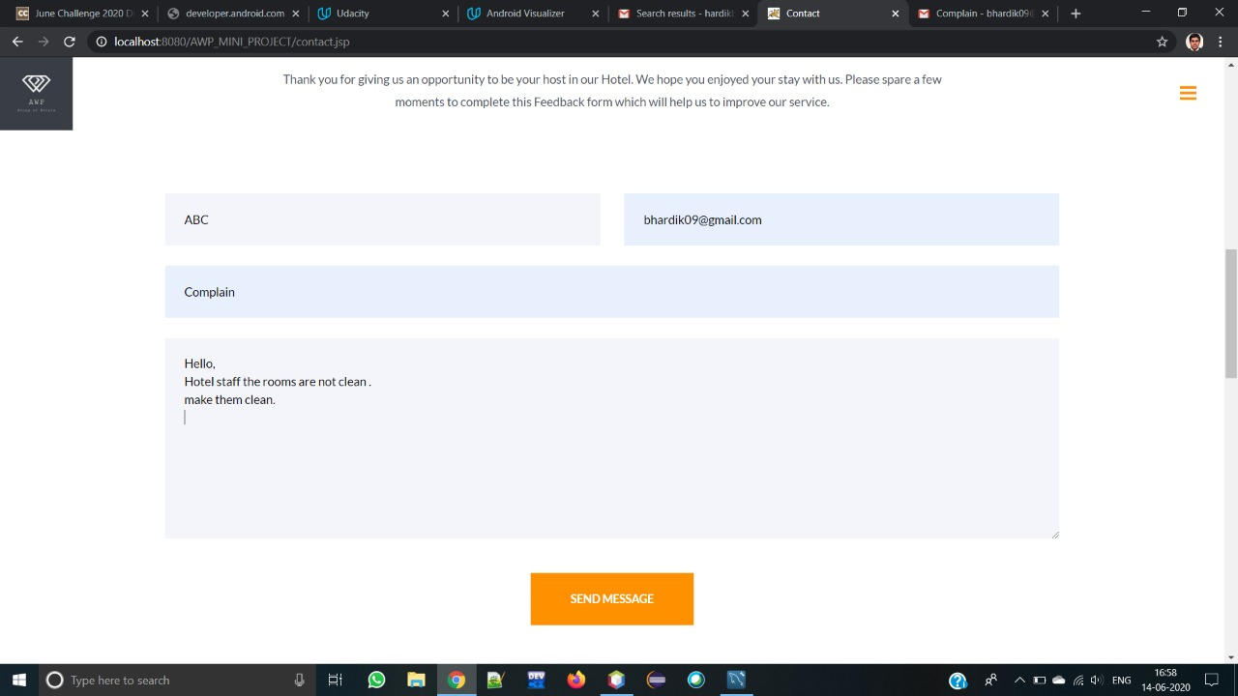
Contact.jsp
You can fill out a feedback in this page, and, it shall be read by our team!
A email of this form will also be sent to your email address!

Slide 13
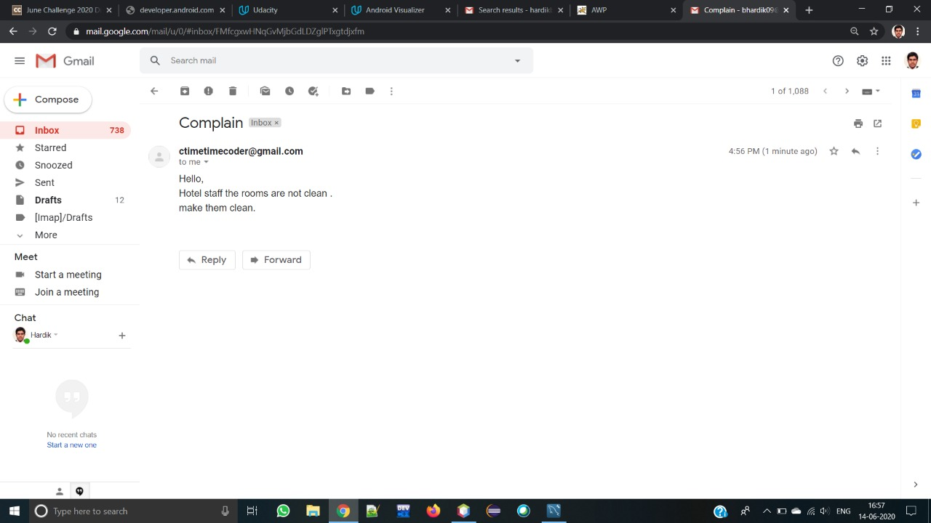
E-Mail
Rest assured, Our team has received your suggestion, and will act on it post-haste!
You will receive a confirmatory Email of your feedback:

Slide 14
MVC
JSP and servlet were used here as following
JSP is used for VIEW, i.e. for dynamic pages displayed to the client
Servlet is used to implement CONTROLLER which will call VIEW by sending the MODEL object
Including JSP and servlet

Slide 15
CSS style with bootstrap
CSS was used here as following:
Bootstrap used here for responsive website
Certain Bootstrap classes have inbuilt validation, which were used to avoid javascript validation in some places

Slide 16
AJAX and JavaScript
AJAX was used here as following:
Dynamic updation of price and availability without having to refresh the page
Used in final.jsp
JavaScript was used here as following:
In validation for login.jsp, registration.jsp
JavaScript for heavy lifting in AJAX

Slide 17
Database handling in MYSQL
MYSQL was used here as following:
Keeping record of admins, users, and rooms, and their effects on each other.

Slide 18
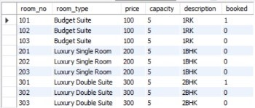
SQL-tables to show how database is stored

Slide 19
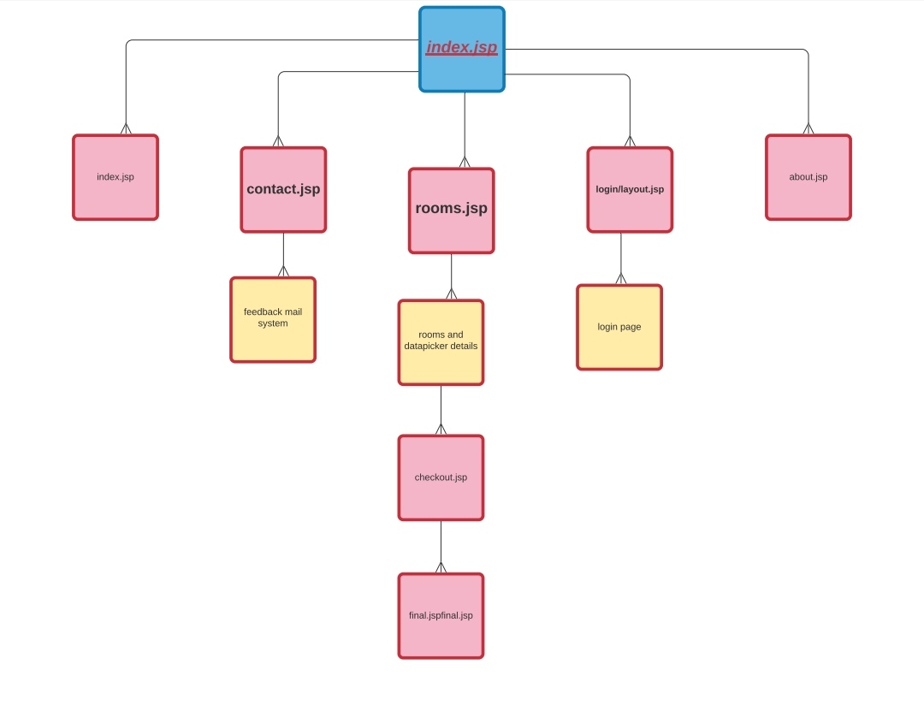
Diagram to explain website structure

Slide 20
Thanks for visiting AWP Hotels
Stay home Stay safe

